Slide 1

Grocery Delivery Route Optimizer Using Q-Learning
Rajeev Goel (12241460)
Vedant Marodkar (12240990)

Slide 2

Problem Statement
What is the most crucial factor for the success of any household delivery services startup?
1. Warehouse/Inventory
Delocalization of Inventory
2. Fast Delivery Services
Optimizing the route b/w shops

Slide 3
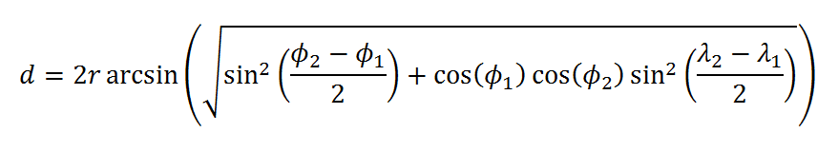


Our Solution: Environment
20Km
Prayagraj
(25.4358 , 81.8463)
no_shops = 7

Slide 4
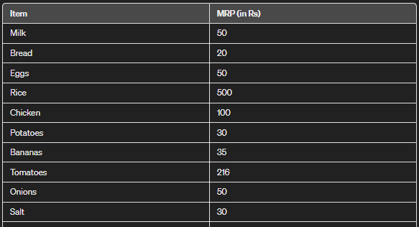
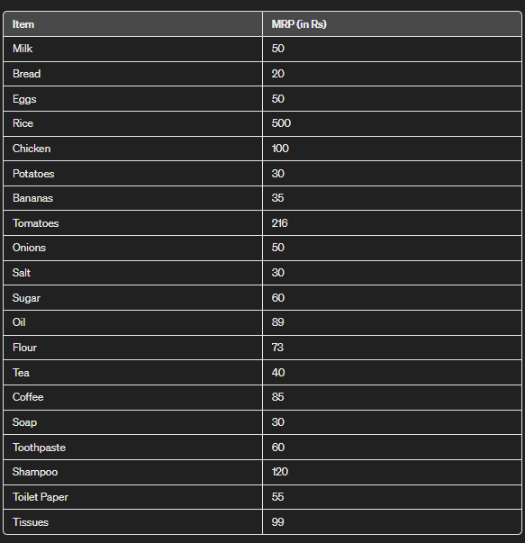
Our Solution: Environment
no_items = 4

Slide 5
State & Action
class State:
def __init__(self, shop, status):
self.shop = shop
self.status = status
Action space = [0,1,2,3,4,5,6] for 7 shops
Shop A
Shop B
Action = B
shop = shop_no between (0-6) for 7 shops
status = (0/1, 0/1, 0/1, 0/1) for 4 items
2
2
(7 x 4 ) x 7 x (7 x 4 ) = 87808 possible transitions
Total No. of states in state-space is
(7 x 4 )
2
3
4
Total transitions states = (no_shops) * (no_items)

Slide 6
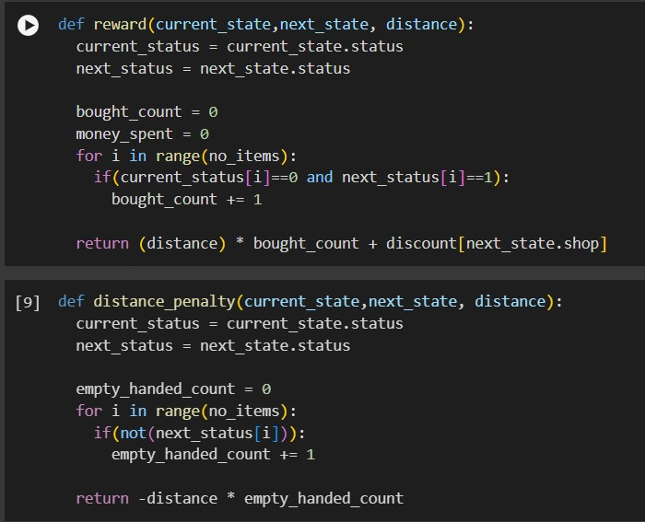
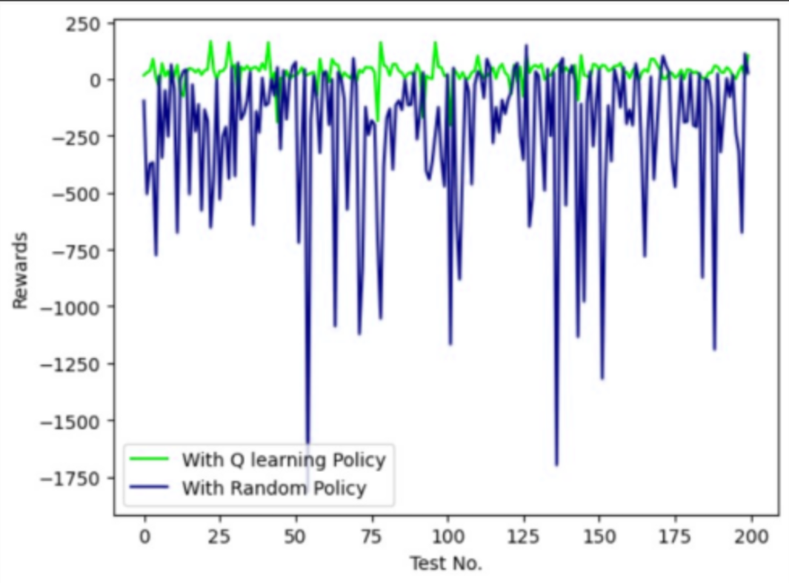
Reward and Penalty Function

Slide 7
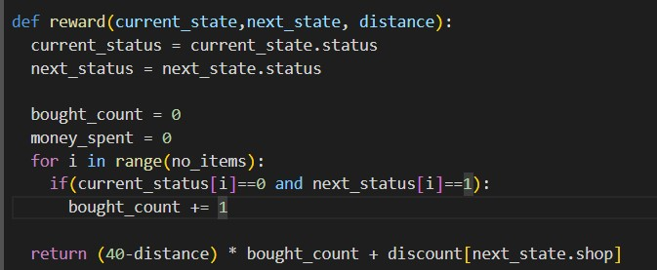
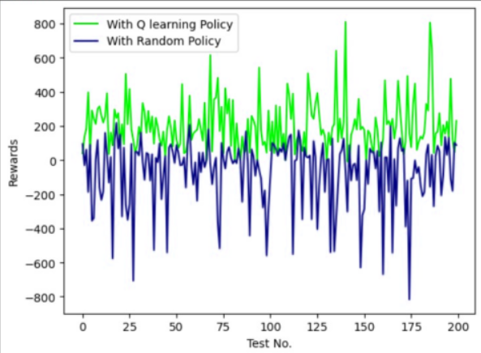
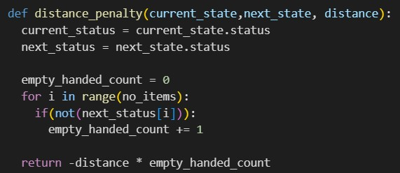
Reward and Penalty Function

Slide 8
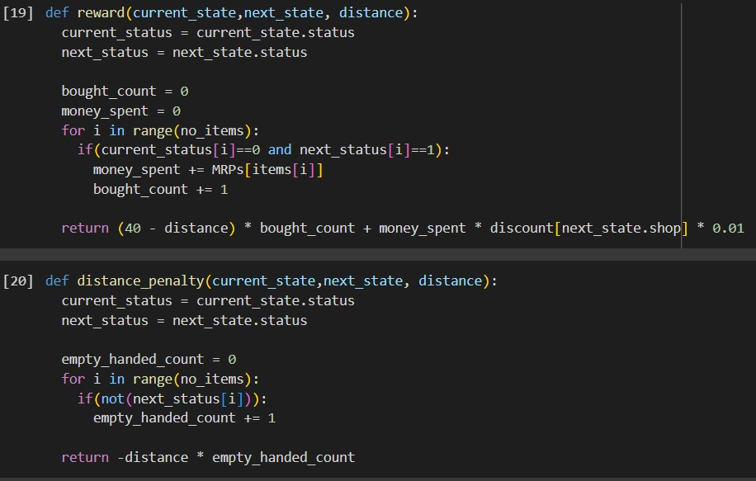
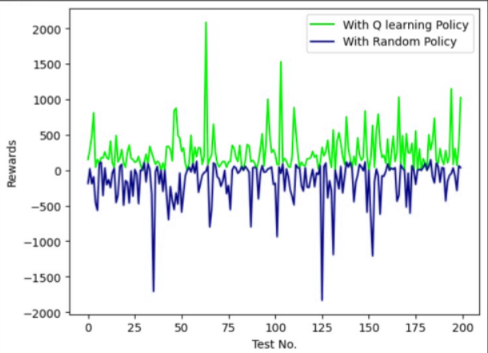
Reward and Penalty Function

Slide 9
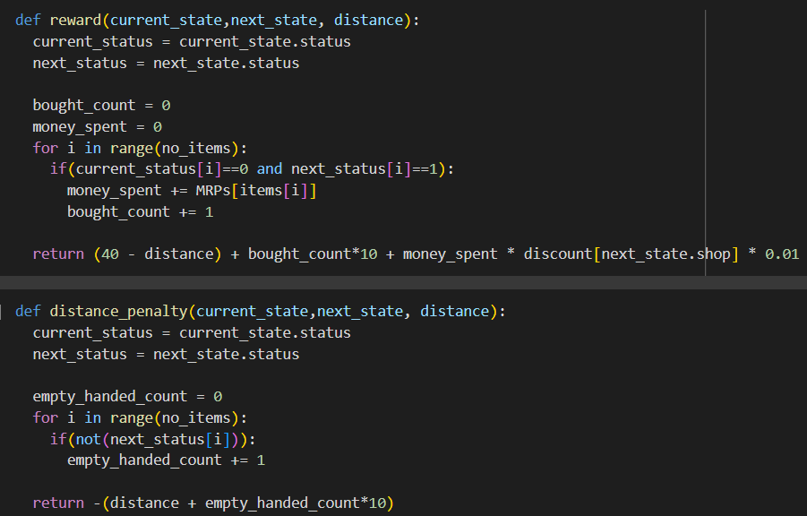
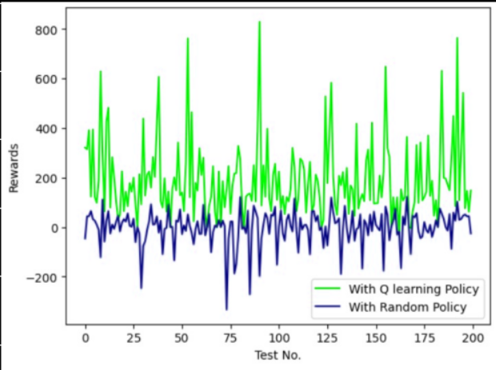
Reward and Penalty Function

Slide 10
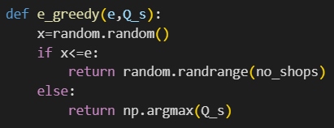
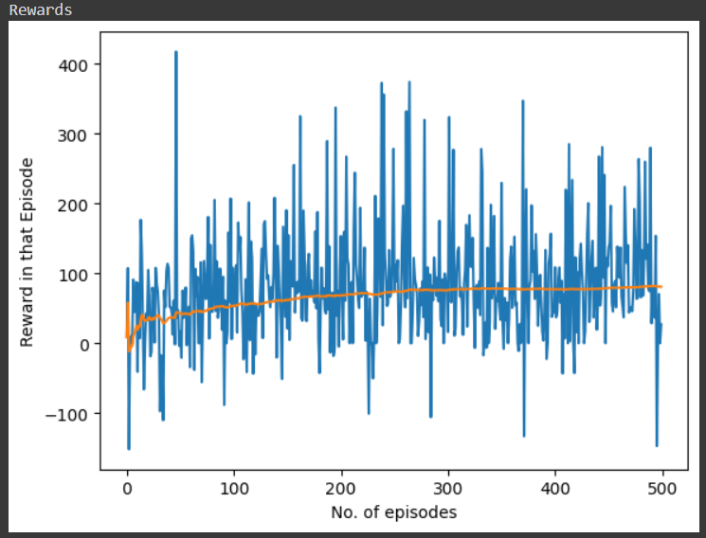
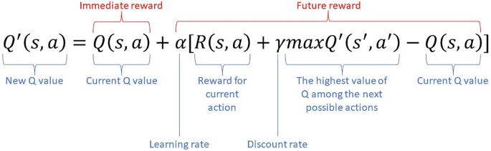
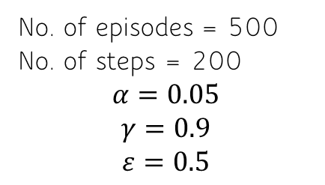
Q-Learning
No. of episodes = 500
No. of steps = 200
$$α=0.05$$
$$γ=0.9$$
$$ε=0.5$$

Slide 11
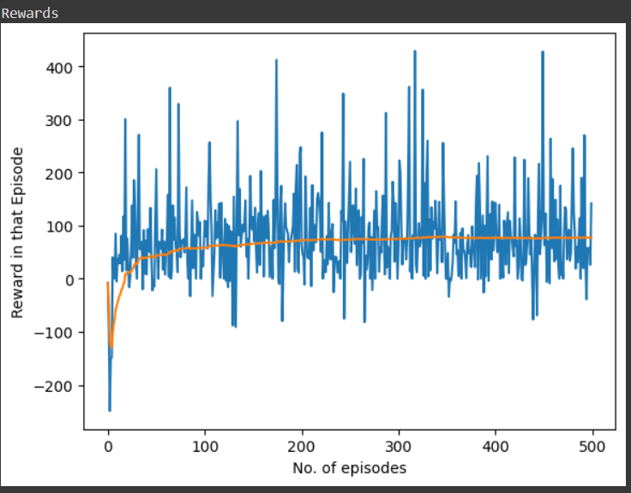
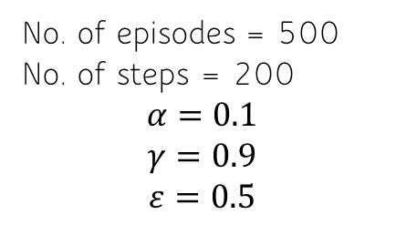
Q-Learning
No. of episodes = 500
No. of steps = 200
$$α=0.1$$
$$γ=0.9$$
$$ε=0.5$$

Slide 12
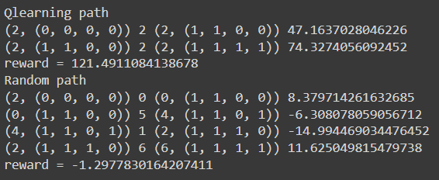
Test Run

Slide 13
Thank You
FUTURE IMPROVISATIONS:
Connecting the locations with google map APIs to obtain exact distance by road between two locations rather than haversine distance.
Visualize the path using an app or web platform.

